Slide 1



view

Slide 2
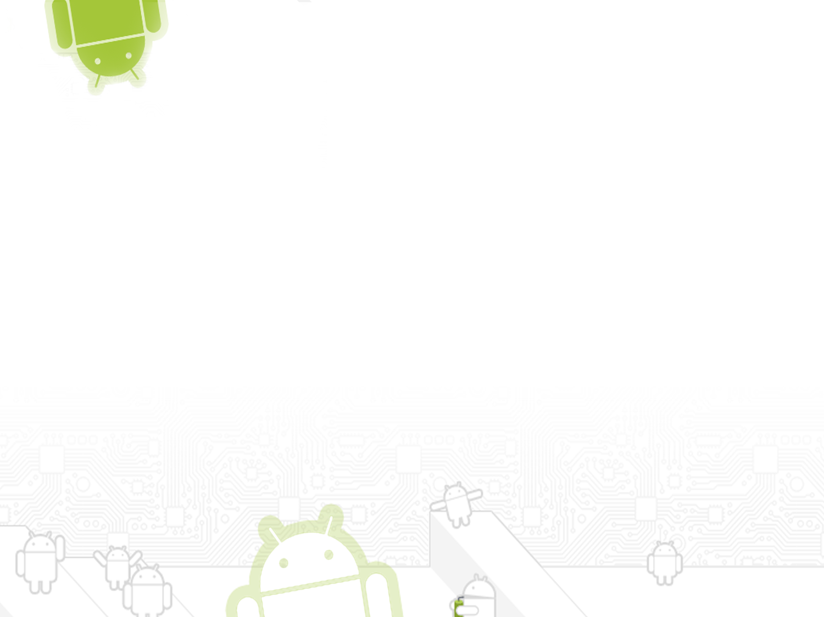
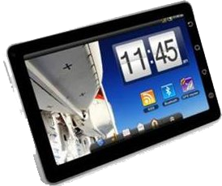

Contents
Views
A Tree-Structured UI
Comparing Android UI to Swing UI Elements
Basic Views
Viewgroups

Slide 3
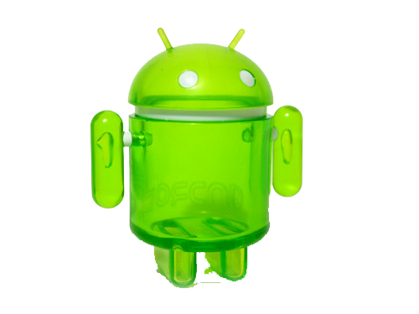
Introduction
The basic functional unit of an Android application is the activity-an object of the class android.app.Activity.
An activity can do many things, but by itself it does not have a presence on the screen.
To give your activity a screen presence and design its UI, you work with views and viewgroups.

Slide 4
Views
A view is an object extending the base class android.view.View.
It's a data structure whose properties store the layout and content for a specific rectangular area of the screen.
A View object handles measuring, its layout, drawing, focus changes, scrolling, and key/gestures for the screen area it represents.

Slide 5
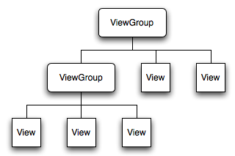
A Tree-Structured UI

Slide 6
Comparing Android UI Elements to Swing UI Elements
Activities in Android refers almost to a (J)Frame in Swing.
Views in Android refers to (J)Components in Swing.
TextViews in Android refers to a (J)Labels in Swing.
EditTexts in Android refers to a (J)TextFields in Swing.
Buttons in Android refers to a (J)Buttons in Swing.
// Android myView.setOnClickListener(new OnClickListener(){ ... // Swing myButton.addActionListener(new ActionListener() {...

Slide 7

Common views that you would likely use in your journey of Android development.
  Basic Views - commonly-used views such as TextView, EditText, and Button views
  Picker Views - views that allows users to select from, such as the TimePicker and DatePicker views
  List Views - views that display a long list of items, such as the ListView and the Spinner views
  Display Views - views that display images, such as the Gallery and ImageSwitcher views
  Menus - views that displays additional and context sensitive menu items
  Additional Views - interesting views such as the AnalogClock and DigitalClock views

Slide 8
Basic Views
TextView
EditText
Button
ImageButton
CheckBox
ToggleButton
RadioButton
RadioGroup

Slide 9
TextView
  One of the most basic user interface elements, or controls, in the Android SDK is the TextView control
  Use it to draw text on the screen.
  Use it to display fixed text strings or labels.
  TextView control is a child control within other screen elements and controls.
  Derived from View and is within the android.widget package.
  The entire standard attributes such as width, height, padding, and visibility can be applied to the object.
  <TextView> is the XML layout file tag used to display text on the screen.

Slide 10
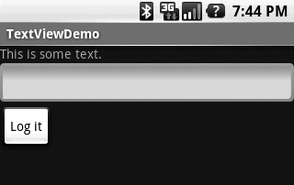
TextView and EditText
  A TextView, as shown in the line "This is some text" in figure.
  A place to display a text string.
  Each TextView has the attributes you'd expect of such a component
  change its height, width, font, text color, background color, and so forth.
  TextViews also have some useful unique attributes:

Slide 11
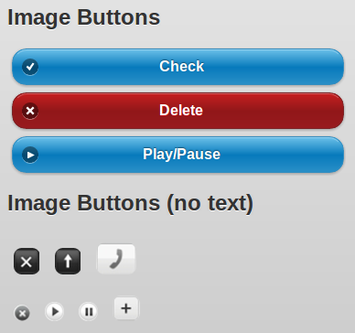
Button and ImageButton
  The Button View is just a button
  Printed with some text to identify
  The user can click to invoke some action.
  Android has a very visual, mobile-oriented user interface
  To use a button with an image on it rather than one with text.
  Android provides the ImageButton View for just that purpose.

Slide 12
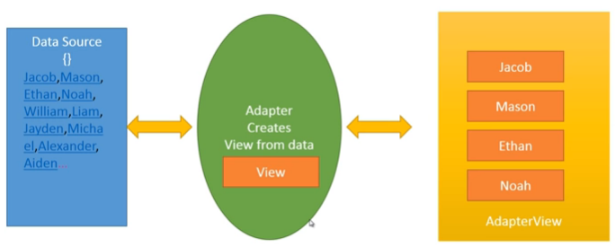
Adapters and AdapterViews
  Adapter is responcible for taking data and Managing data.
  Adapter Access the data and creates a view that displayed with in the Adapter View.
  AdapterView contains a set of views that display the data from a data sourse .
  ListView, GridView, Spinner(dropDownMenu), and Gallery are all handy subclasses of AdapterView.

Slide 13
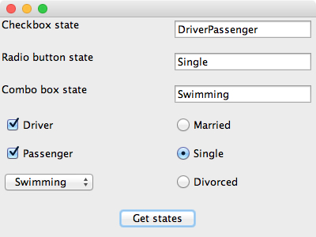
CheckBoxes, RadioButtons, and Spinners
  CheckBoxes are typically used when you want to offer multiple selections with a yes/no or true/false choice for each.
  RadioButtons are used when only one choice is allowed at a time.
  Spinners are similar to combo boxes in some frameworks.

Slide 14
Viewgroups
A viewgroup is an object of class android.view.Viewgroup.
viewgroup is a special type of view object whose function is to contain and manage a subordinate set of views and other viewgroups.
The Viewgroup class serves as a base class for layouts - a set of fully implemented subclasses that provide common types of screen layout.
Like LinearLayout , RelativeLayout , FrameLayout etc.
ViewGroup is generally used to define the layout in which views(widgets) will be set/arranged/listed on the android screen.
The layouts give you a way to build a structure for a set of views.

Slide 15
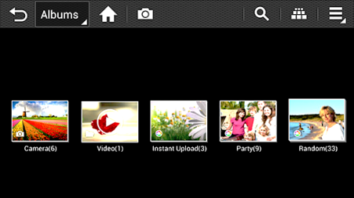
Gallery and GridView
  The Gallery allows you to view pictures and videos you have captured. With photos, you can access the edit functions, set an image as a contact photo or wallpaper, or share the image.
  The GridView displays many child Views that the user can manipulate.
  The Gallery and GridView classes both descend from the AdapterView class

Slide 16
Gallery and GridView
  Slideshow: Start a slideshow of the image files in the gallery.
  New album: Create a new album.
  View by: Choose the content you would like to appear in the Gallery. Select from All, Content in device, Content in Facebook, and Content in Picasa. If the option is grayed out, there is no corresponding account present on the device.
  Select album: Select multiple albums to Delete, Share, or view a Slideshow.
  Scan for nearby devices: Scan for nearby devices you can share with wirelessly.
  Hide/Show nearby devices: Hide or show nearby devices' albums.

Slide 17
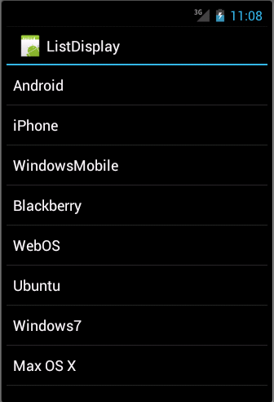
ListView and ListActivity
  ListActivity is a subclass of Activity that includes a ListView object
  Through ListActivity class you can create an activity in your Android application that can be connected to different data sources (query cursor or arrays)
  It can be displayed as a set of list items on the screen.
  Filling the ListView in the ListActivity is a simple matter of calling setListAdapter and passing it an ArrayAdapter that
  contains a reference to the list of strings.

Slide 18
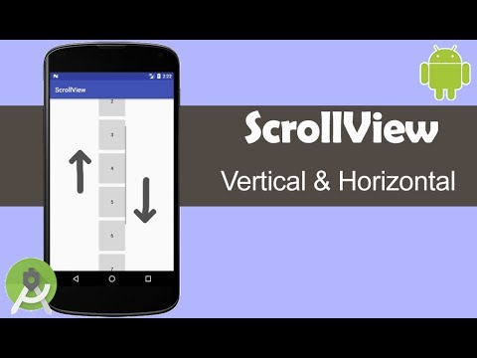
ScrollView
  A ScrollView is a container for another View that lets the user scroll that View vertically
  A ScrollView often contains a LinearLayout, which in turn contains the Views that make up the form.
  The ScrollView, on the other hand, allows an arbitrary View to scroll vertically
  The Android documentation warns that one should never house a ListView within a ScrollView,

Slide 19
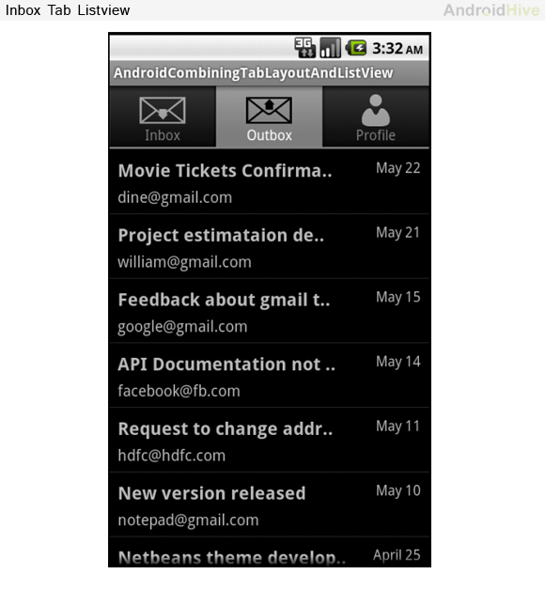
TabHost
  Most modern UIs provide an interface element that lets the user flip through many pages of information quickly using tabs
  with each "screen" of information available when its tab is pressed
  Android's option is the TabHost View.
  Android enables the developer to choose between three different approaches for setting the tab's content.
    Set the content of a tab to an Intent.
    Use a TabContentFactory to create the tab's content on-the-fly.
    Retrieve the content from an XML layout file, much like that of a regular Activity.

Slide 20
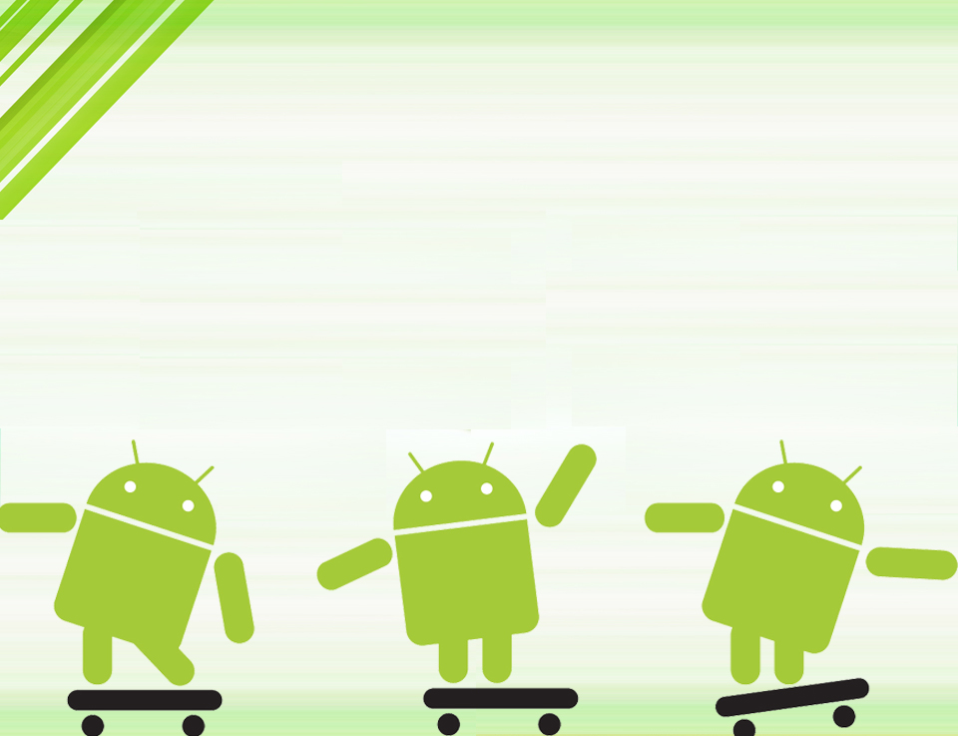
Thank you

